Slide 1

Rare Connect
Rare
Connect
Arman Mahjoor, Saurabh Basak, Tahir Ismailwala

Slide 2
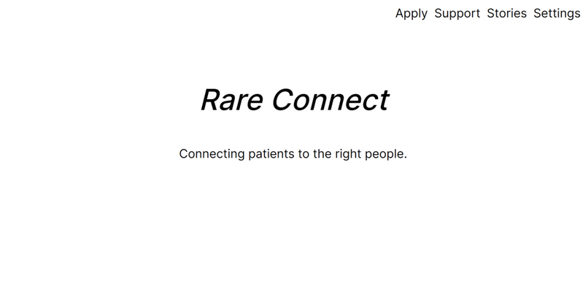
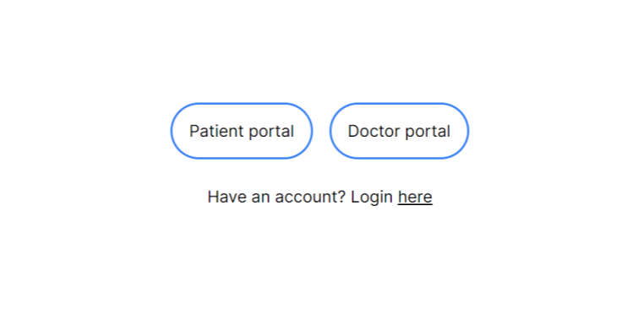
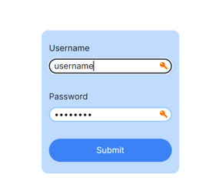
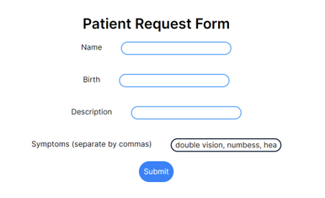
Rare Connect
Problem You’re Tackling
Misdiagnosis and Access to Information
Challenge: Individuals with rare diseases often struggle with getting an accurate diagnosis, leading to delays in treatment and increased psychological stress.
Isolation and Lack of Support
Challenge: The rarity of these conditions can lead to isolation and a lack of understanding from the broader community.

Slide 3
Rare Connect
Relevant Literature
Websites
HIPAA
https://hodassoc.org
https://www.foxp1.org/characteristics
https://usp7.org/signs-and-symptoms
https://www.curecmt4j.org/cmt4j/
https://alportsyndrome.org/about-alport-syndrome/diagnosis/
https://dup15q.org/understanding-dup15q-syndrome/

Slide 4
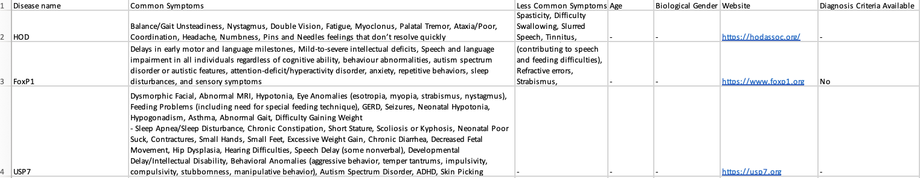
Rare Connect
Data Worked With
Identified from rare disease websites
Symptoms
Demographics (has some weight but does not rule out minority populations)
Psuedo Database

Slide 5
Rare Connect
Methods
Artificial intelligence
Python ML
CNN’s
Backend
Python
Frontend
Typescript

Slide 6
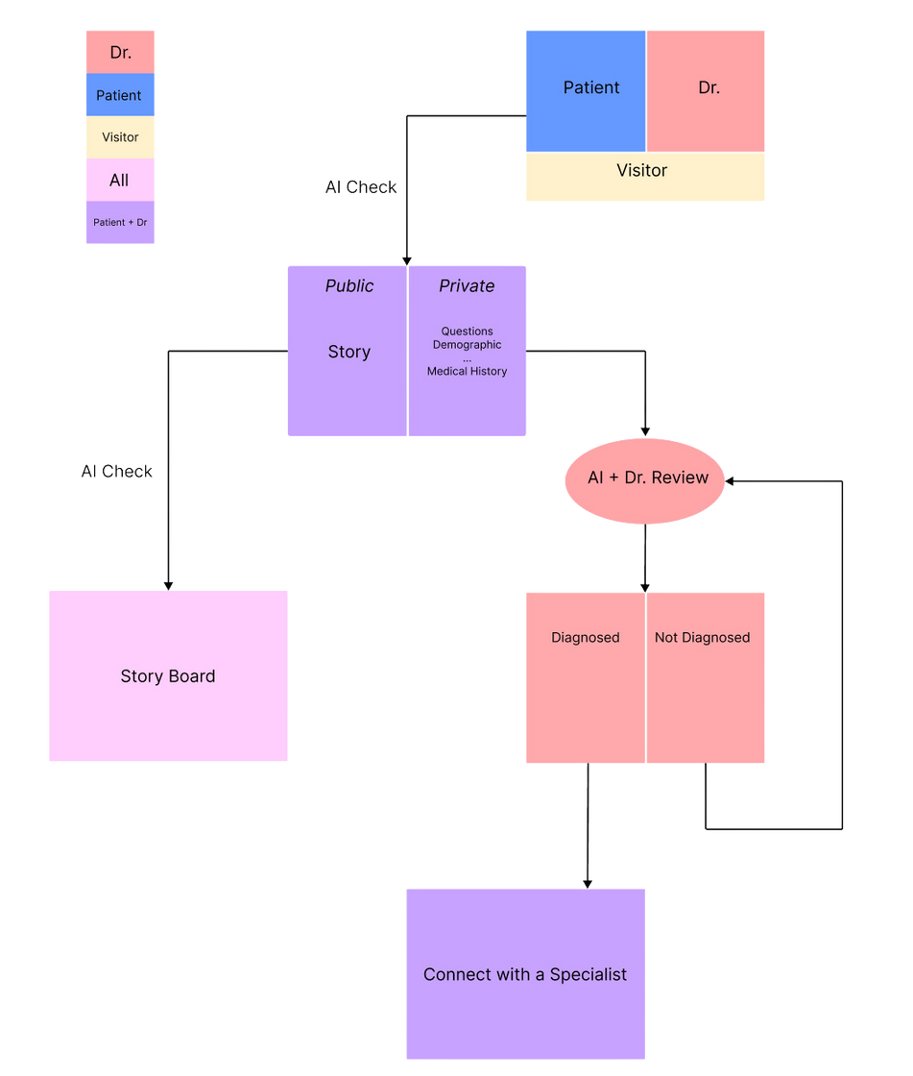
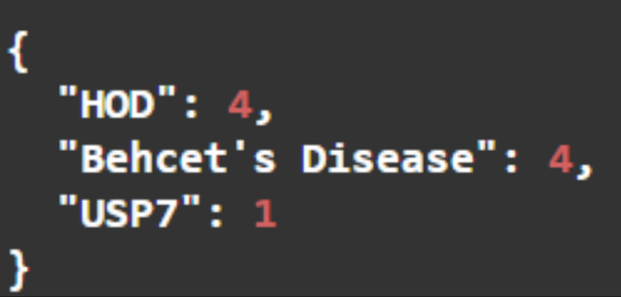
Rare Connect
Results
Created a conceptual design of the platform
Mock algorithm with sample data set to model AI
Symptoms
Application Thought Process
Expected Output

Slide 7
Rare Connect
Discussion
Limitations
Funding
Must be compliant with HIPAA
Outreach
What’s been done
Doctor Patient Online Chatting
https://compliantchatgpt.com/
Why it’s different
Focused on the Rare Disease space

Slide 8
Rare Connect
Challenge and Future Directions
Implementation
Funding → getting sponsors or backing through companies or investors
HIPAA compliance
Making the platform a key aspect of the rare disease community

